Slide 1
Gradesheet Management System
Presented By:
Siddhartha Shakya
BIM (B)

Slide 2

Introduction
The Gradesheet Management System is a software tool built using the C programming language, designed to manage and maintain student gradesheet efficiently.

Slide 3
Objectives
To enhance the efficiency of gradesheet management in educational institutions

Slide 4
Features
Simple and intuitive user interface
Automated grade calculations
Comprehensive report generation
Data storage using file handling
Easy data entry and retrieval

Slide 5
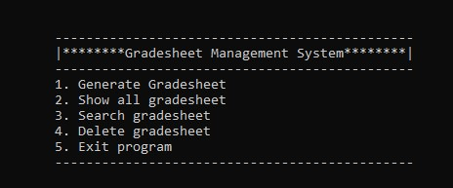
Functions of The Application
Generate Gradesheet: Create a new gradesheet
Show all Gradesheet: Display saved gradesheet
Search Gradesheet: Retrieve student gradesheet
Delete Gradesheet: Remove the saved gradesheet

Slide 6
Advantages
Reduces manual errors in grade calculations
Provides quick access to student performance data
Ensures organized data storage
Facilitates easy generation of reports

Slide 7
Conclusion
The Gradesheet Management System built using C language is a robust solution designed to simplify the process of managing student grades.
Its features and advantages make it an essential tool for educational institutions seeking efficiency and accuracy in grade management.

Slide 8
